Slide 1


Slide 2
Using Location
IN721 2017
Design and Development for Mobile Devices
Session 10.1
Notes:
By definition, one of the distinguishing factors of mobile devices (compared to desktops) is that they move around.
Thus, any use case that requires knowledge of location – checking in, finding information about surroundings, labeling content with location, etc. -- is appropriate for mobile.
Most modern Android devices have onboard GPS chips that give varyingly accurate location information.
Localisation by wi-fi address is also possible.
The Android libraries can use both of these approaches to determine where a device is.
There are two APIs for location – android.location and the Google Play services Location API. The former is much simpler, and we will start by looking at it.
The latter is more powerful and is “preferred” (by Google) but much more complicated. Its specific strength is that it automatically handles switching between the phone’s two localisation algorithms, so you don’t have to code that. We will look at the second approach, in the context of Google Play services and Google maps, later.
Since the Google Play API actually uses the Android API (that is, it is a wrapper), the Android API is unlikely to be deprecated, so it is safe to use.
Let’s start, though, by looking at how location is determined

Slide 3
Trilateration – Location from Distance
C
D_{c}
A
D_{A}
B
D_{B}
Notes:
GPS devices actually compute location by using distance from multiple fixed points.
The phone finds its location in 3 dimensions, of course, but it’s easier to understand the algorithm in 2 dimensions, so let’s start with that.
Imagine that there is a fixed point A, and you can somehow determine how far away you are from A. This is quite easy to do with, for example, a sensor that measures the round trip time of a signal bounced off A.
Lets call this distance DsubA. Since you are DsubA units from A, you must be somewhere in a circle with of radius DsubA, centred on A.
Now read your distance from a second fixed point B, DsubB. Again, this places you somewhere on a circle of radius DsubB, centred around B. Since you are simultaneously on both circles, you must be at one of the two points where the circles overlap.
If you add your distance to a 3rd fixed position, C. Circle C can only intersect one of the two possible points where A and B overlap, and that’s where you must be standing.
GPS location works exactly like that except that, because it is in 3D, you have overlapping spheres, and you need four of them.
You GPS receiver determines its distance from 4 satellites in the GPS constellation, and trilaterates its precise location by constructing the spheres around the satellites’ locations at that instant.

Slide 4

Trilateration – Location from Distance
Notes:
Here’s the 3D version of the figure (from moorefarmsbg.org)

Slide 5
Phone Options (simplified)
GPS
Receiver determines your distance to four Global Positioning System satellites and computes your location via trilateration.
Very accurate (in most places).
Doesn’t work indoors.
Consumes a lot of battery power.
Network location detection
Uses distance from nearest cell towers and/or WiFi access points.
Trilaterates if sufficient distance values available.
Less accurate than GPS
Notes:
Accuracy dependent on satellite coverage, and NZ’s isn’t perfect, apparently.
The GPS receivers in phones require line of sight to the satellites, so roofs are a problem.
So there is an alternative:
Network location detection can be more accurate if there are sufficient towers
The use of WiFi systems for location is ongoing and interesting. Reference available if you want more technical detail.
So assume that our phones know (approximately) where we are. What code do we write to find that out?

Slide 6
Permissions
<uses-permission android:name="android.permission.ACCESS_FINE_LOCATION“/>
<uses-permission android:name="android.permission.ACCESS_COARSE_LOCATION“/>
Notes:
Your app must signal its desire to use both location options by adding these XML statements to AndroidManifest.xml
FINE is GPS
COARSE is Network
NB: Under the most recent permissions model, there is a little more work to be done for location checking than there was for accessing the internet.
We will go ahead and cover the syntax of working with location, then come back to the permissions issue.

Slide 7
Basic Location
android.location libraries
Process:
Get a LocationManager instance
Define a Criteria class instance
Get a provider
Ask for your location
Notes:
You can start with the android.location libraries.
They are part of the Android core, require no further configuration, and are easy to use.
As mentioned, Google provides a snazzier API that we will consider later.
The built-ins are more than sufficient to get you started with localisation of your apps.
You’ll get the LocationManager from your Activity
Criteria holds a set of options, we’ll look at it in a moment
Provider is GPS or Network (or other possibilities depending). This is a string value (!)

Slide 8
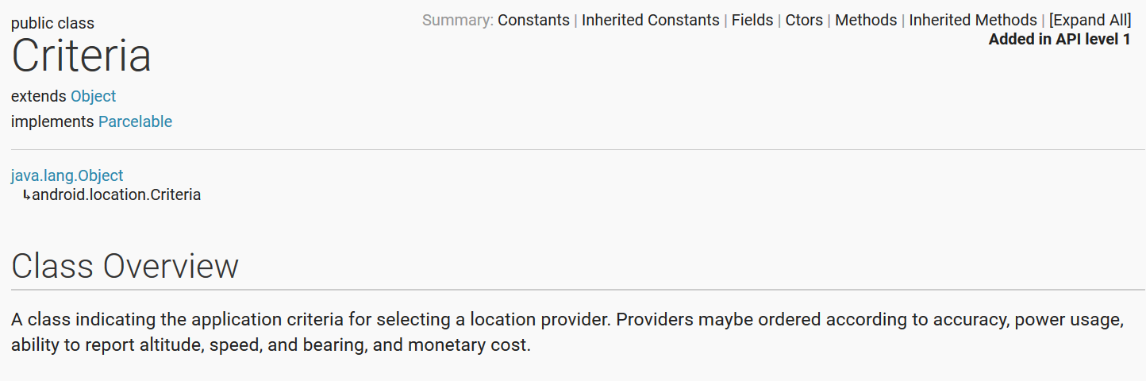
Critera object
developer.android.com/reference/android/location/Criteria.html
Notes:
Allows you to specify things like required accuracy, power consumption, etc. so as to modify the algorithm used based on the specific needs of your app.
If you just use the default (i.e. a created instance with no settings provided), the system will algorithmically choose an approach.
For my locally running demo app, it uses “gps” as its provider.
See docs for details.

Slide 9
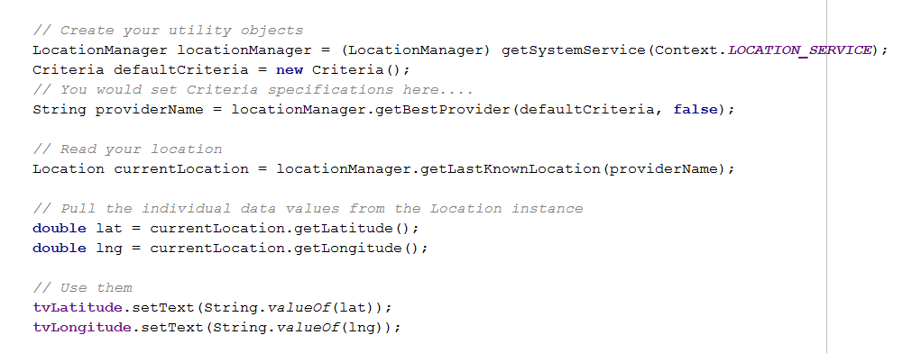
Basic Location (up to SDK 21 only)
Notes:
If you put this in a button click handler, and provide the correct text controls, you get an app that looks like this...
(provideName will be “GPS” or “Network”
This assumes you’ve got location services active, so that the system has checked its location at least once.
We will see in more detail in a minute how to do this part; it is a little complicated.
This also omits the permission check for more recent versions of the SDK, which we will also see in a minute
Note that you can force the system to use either GPS or Wifi if you need to (i.e. You can override the default). See docs.

Slide 10
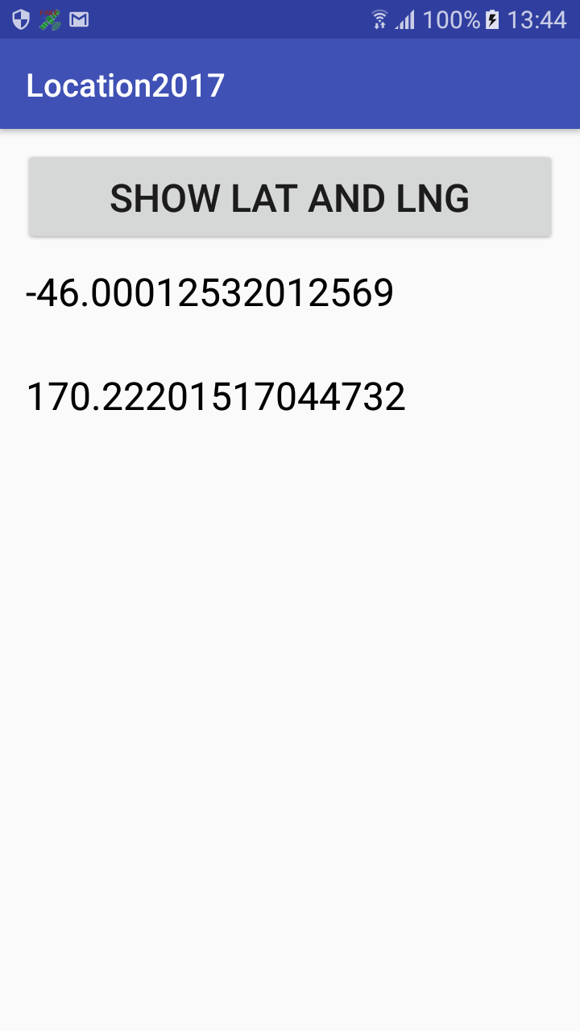
Basic Location
Notes:
Assuming you are in Dunedin and your phone has been set to actively monitor its location (more later on how to do this ourselves programmatically).
This is running on a real phone, where it is easier to work with location – the emulator is temperamental in this area; we will discuss how to do that a bit further on.
For testing, it’s not very interesting if you are stuck in one place – it also won’t help you test any functionality that is dependent on location such as “find me X in my area”.
There are a number of apps that will let you manually change your GPS location, overriding the actual trilateration of the phone hardware.
The department phone has this one...

Slide 11
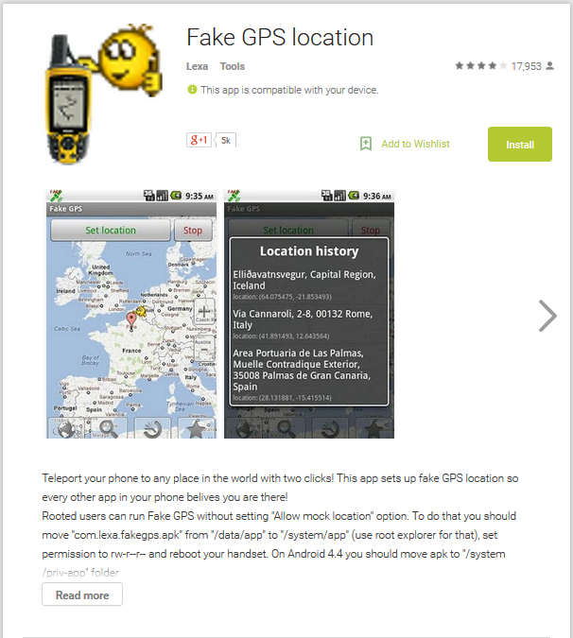
Location modification for testing
Notes:
Free from Lexa software
Install it and turn on “Allow mock location” setting on your phone.
NB: No promises that this won’t hurt your phone, violate your privacy, etc. I have not looked deeply into it and am only using it on the departmental phone. If you don’t want to use it on your personal phone, I don’t blame you. You can use the department test phone or the emulator (see later slides), instead.
A bonus of using a tool like this is that it sets up the location monitoring (as we have referred to before) so that “getLastKnown” will work. So if you are just starting out and you find that getLastKnowLocation is returning null, using the spoofer should solve that problem.

Slide 12
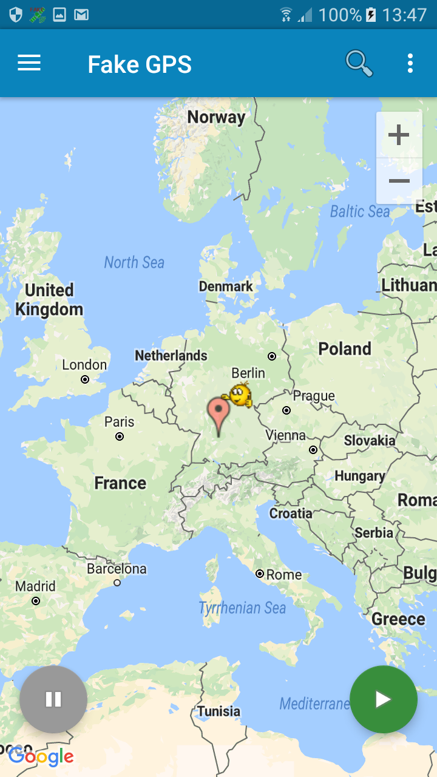
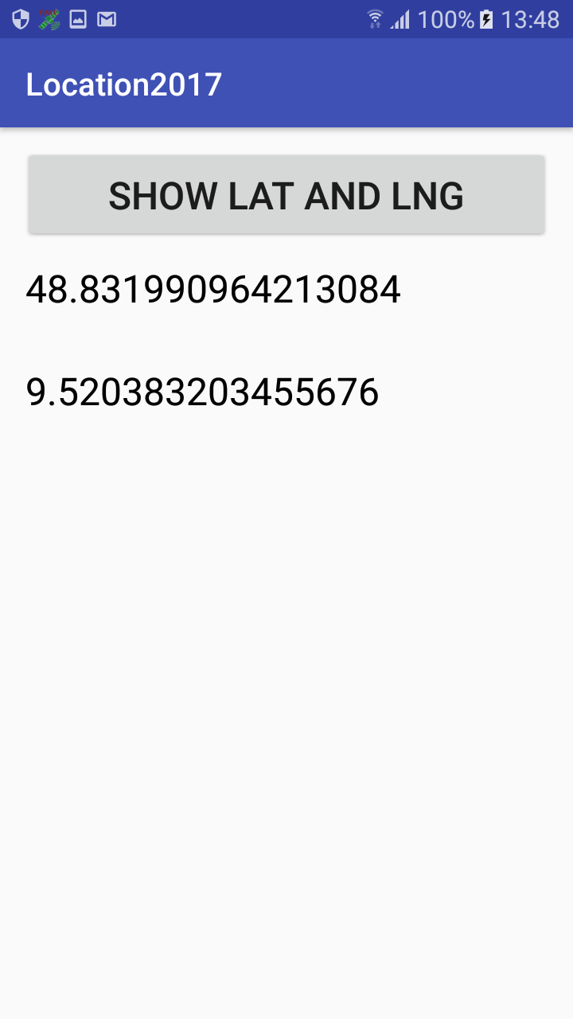
Location modification for testing
Notes:
Slide the map around – the icon stays fixed.
Click the Green button
If you run your app again...
Click Stop to return to normal GPS reading.
Spoofing location is harder on the emulator; we’ll talk about that in a minute.

Slide 13
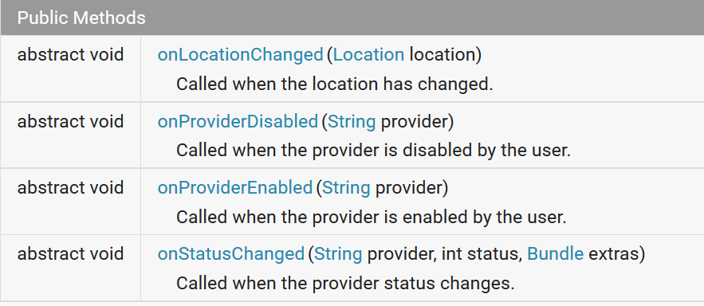
Continuous Location Monitoring
Interface LocationListener
Notes:
In our example app, we set the location using another app (FakeGPS) then called getLastKnownLocation on a button press.
An alternative processing flow is to have the app monitor (poll) for changes in location and perform some action whenever it detects a change of a certain magnitude.
You see this happening when, for example, your phone automatically requests permission to update the clock when you change timezones.
To make this happen, you create a class that implements interface LocationListener.
This interface contains a number of methods for polling location and responding to various events.
You call a method of your LocationManager and pass in your LocationListener to turn on polling.
We start with the LocationListener interface.
Here are the four methods.
Today we will use only onLocationChanged.
After you have turned on polling, this event is raised whenever the system polls and detects a change of at least the specified magnitude has occurred.
Polling interval and minimum change are set when we use the LocationManager to turn on polling.
Without the button
LocationListener interface
LocationManager.requestUpdates ➔ Polling for change
If implemented, can spoof in emulator
ADM
spoof

Slide 14
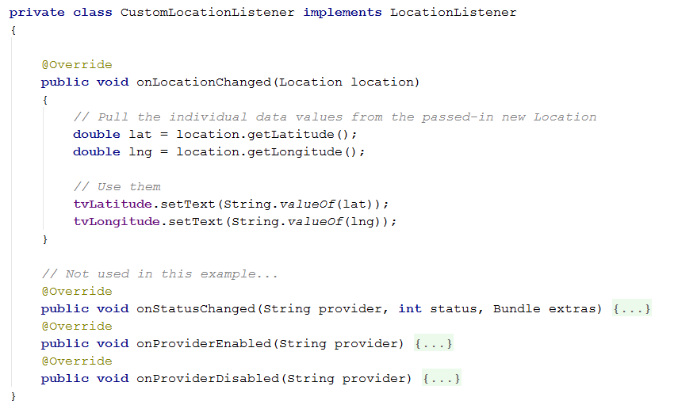
Continuous Location Monitoring
LocationListener
Notes:
So we might add this inner class to our app
We set up the class and move the UI part of our button click handler into onLocationChanged.
AFTER WE TURN ON POLLING...
When the location changes, that event is raised, the new location is passed in and we see the result.
We don’t need to click the button.

Slide 15
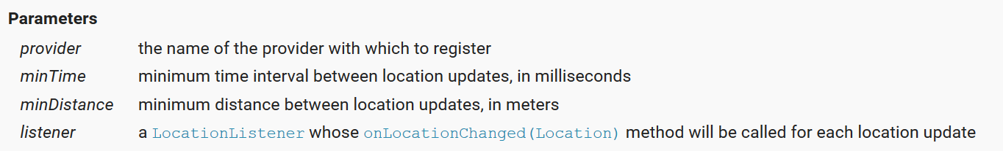
Continuous Location Monitoring
To turn on polling call LocationManager.requestLocationUpdates
Notes:
Therefore, if I add this line of code:
where? => in the onCreate; move the setup of locationManager up there as well)
my app will poll every 400 msec, or if it has been more than 400 msec since it last checked if it has been backgrounded
A difference of more than one meter from the previous reading will count as “change”.
The onLocationChanged method of my CustomLocationListener() will be called, with the new location passed in.
In my demo app on the phone, this means that when I move with FakeGPS and go back to my app, I automatically see the lat and lng update (after 400 msec), without having to click the button. Or, if I turn off FakeGPS, pick up the phone and walk around with it (outside), the output changes every 400 msec if I move more than a metre.
Another advantage of this architecture is that, when you get it running, you can spoof GPS in the emulator.
Here’s how...

Slide 16
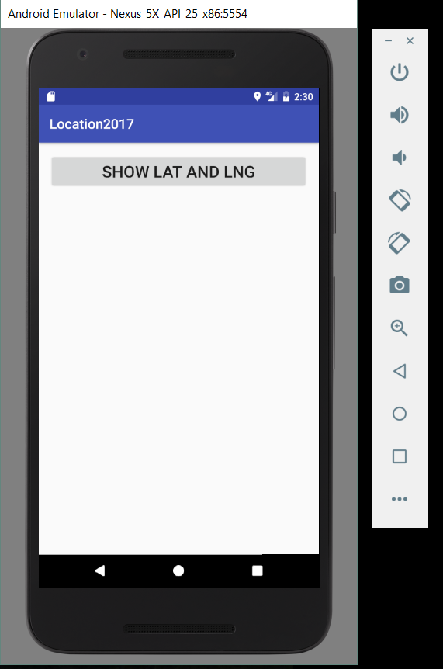
Mock GPS with the Emulator
Notes:
Start your app in the emulator, then click the ellipsis on the emulator toolbar
NB: Will need the modern permissions here, or roll back to 21.

Slide 17
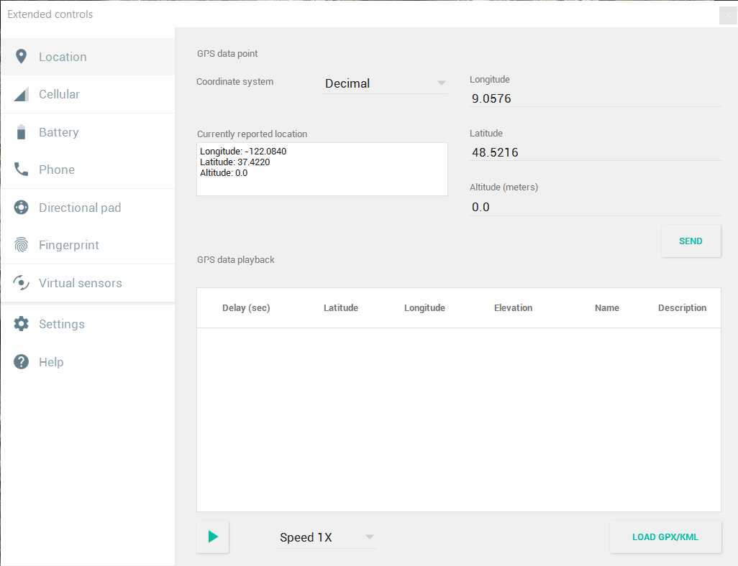
Mock GPS with the Emulator
Notes:
Type new values in the Longitude and Latitude boxes, and click the Send button
When you input new values and click Send, onLocationChanged will fire, (assuming enough time has passed and the minimum distance is achieved).
In our sample app, we see the values on the emulator screen change to reflect the new values supplied from the ADM.
NB: This “change from the ADM” doesn’t work without LocationListener (i.e. just with getLastKnownLocation) because the emulator doesn’t listen for location changes by default.
The real phone can be set up to do so. How does this happen? => Some background app/service has set up the polling, so when you call getLastKnowLocation, you are bouncing off that app’s work.

Slide 18
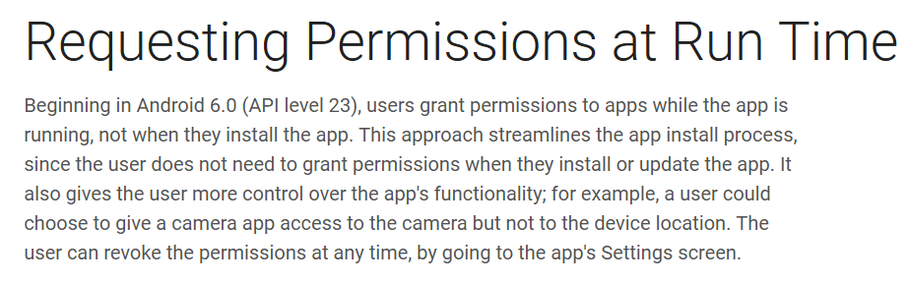
The New Permissions Model
Notes:
From android.developer.com
If you try to use the code we have just seen with SDK 23 or newer, it won’t work. A permissions exception will be thrown.
From 23 on, just putting permissions in the manifest isn’t enough. You have to check explicitly that permissions have been granted before executing a restricted statement.
The new permissions model is designed to make permissions management less onerous for the user by making it more onerous for the developer.
Previously, you just stuck the permissions into the manifest and the user had to grant them at install time.
After that, they were granted forever for that app.
Now, for the reasons stated, you have to make an explicit check at runtime every time.
The first time the check is made (the first time the restricted code is run), the user is prompted to grant the permission(s) with a dialogue window.
The result is stored as part of the persistent state.
Subsequently, you must, in the code, check for that permission every time.
If nothing changes, the code just runs. But if the user has revoked the permission (through the application manager in settings), you must prompt again.
The “prompting” process is a little complicated, because it is run asynchronously with a callback.
We will look at the whole structure a piece at a time, because it is a bit syntactically dense.

Slide 19
The New Permissions Model
Normal vs Dangerous Permissions
Normal: If listed in the manifest, automatically granted
Dangerous: Must be listed in the manifest, and the user must give explicit permission.
Dangerous Permissions:
Calendar Camera Contacts Location | Microphone Phone Sensors SMS Storage

Slide 20
The New Permissions Model
Your app must check every time it wants to execute a statement that requires a dangerous permission, not just on installation.
When permission is granted, it remains in effect unless the user changes it in the application settings
If the permission is not currently granted, you must prompt the user via a system dialogue.

Slide 21
The New Permissions Model
Stating a permission is needed
uses-permission in the manifest as before
Checking for a granted permission
int checkSelfPermission(Context context, String permission)
Requesting permission (2 methods)
void requestPermissions (Activity activity,
String[] permissions,
int requestCode)
@Override onRequestPermissionsResult(int requestCode,
String[] permissions, int[] grantResults)
Notes:
The syntactic parts
checkSelfPermission returns an int. In absolute terms, 0 for yes and -1 for no. But in our code we will use system constants here, for the usual reasons.
You need to use the correct version of checkSelfPermission for when it is called from an Activity or a Fragement (see example code in a minute).
requestPermissions launches the dialog asynchronously. The system builds the dialog window for you; the developer cannot control this.
requestCode can be any integer. You use it to distinguish between multiple permission requests, if you have them.
While the window is up, the main thread is not blocked.
When the user responds, the onRequestPermissions callback is executed. The requestCode, an array of permissions and an array of what the user responded are passed into the callback.
This all gets quite complicated, so we will, naturally, make it modular....

Slide 22
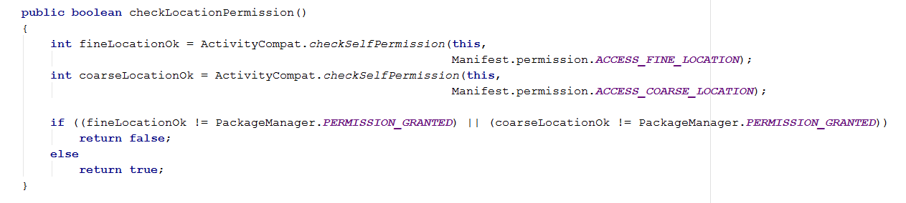
Check Permission
Notes:
Here is how to use checkSelfPermission to see if Fine_Location has been previously granted, assuming you are calling from inside an Activity.
Note the use of the owning class and system string constant
We want a method to check both Fine and Coarse and to return true if they are both granted and false otherwise.
That method should look like this...
Note the method name. Subroutines that do this job need to be named check...Permission or you will get a compiler warning (red line) when you try to use the restricted resource telling you to check permissions, even though you have. From a language design perspective, this is silly, and will probably be rolled away eventually.

Slide 23
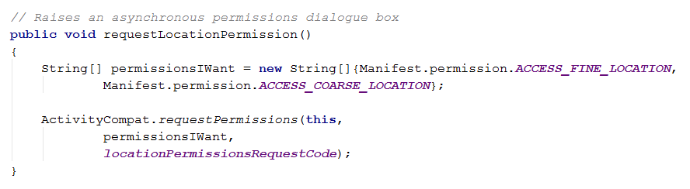
Request Permission
Notes:
We need to set up the array of permission string names, and pick a request code.
I have set my request code up as a static final int set equal to 42
The method to bundle this up would look like this...

Slide 24
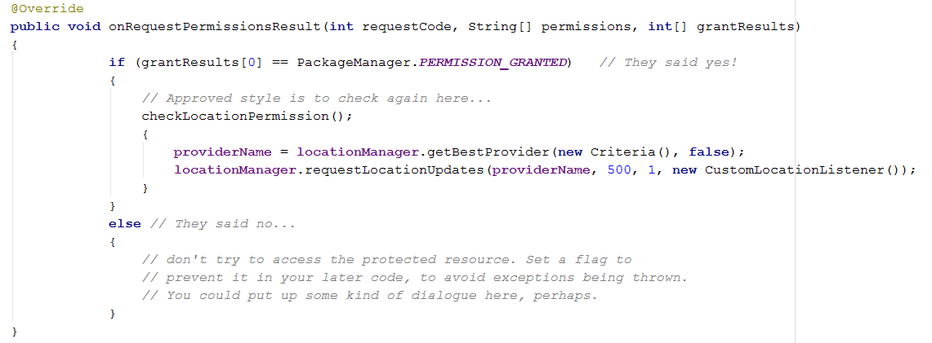
Callback
Notes:
Here is the callback.
This is just a method that goes in the body of your Activity class, like any other.
It is an override of a parent method, specifically, the one that is consequent upon an ActivityCompat.requestPermissions call
Some details omitted to save space:
If you have multiple callbacks, use requestCode to distinguish.
If you have asked for individual permissions to be granted for multiple groups (see docs) look at the different elements of grantResults
IRL, check that grantResults is not length=0, which can happen if the user cancels the dialogue rather than responding
On some phones, you may need to do a getLastKnownLocation the first time here, to start the GPS up.
Note that although the compiler will let you still make the dangerous call in the else part (where the user has denied), it won’t work. The system keeps track of that denial, and when you try to access the restricted resource, a security exception is thrown.
So, let’s assume we want to have all this stuff set up when the app launches, so we want it to happen in the onCreate.
We put it all together, like this...

Slide 25
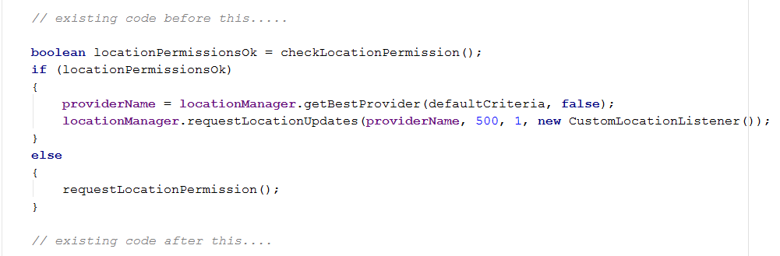
In the onCreate
Notes:
Still need to create the locationmanager and the Criteria instance and then sort the buttons and textviews as before.
Probably will want to put those two lines of code into a method, since they are dup’d here and in the onRequestPermissions handler.

Slide 26
Practical

